Slide 1
Navigating Copyright: The Right2Pub project approach
Ginevra Peruginelli (Istituto di Informatica Giuridica e Sistemi Giudiziari (IGSG-CNR)
Law via the Internet 2024, Limassol,
26 September 2024

Slide 2
Index
Secondary publishing right & Rights retention in Europe
The Project Right2Pub – Balancing publication rights
Some results
Advocacy activity

Slide 3
Rights Retention
Rights retention: An expressed position setting out the practice of retaining sufficient rights for academic works produced by an institutions’ researcher to make the work openly accessible and reusable immediately
The traditional model of scientific publishing relies on researchers transferring their ownership rights to publishers, who can then publish and distribute the research results for commercial purposes
This model is not applied by all publishers. Some publishers allow authors to retain their rights when publishing their work.
Notes:
SPR non è una nozione giuridica rigida, quanto un termine di advocacy che comprende diversi strumenti, sia nell'ambito del diritto d'autore che al di fuori di esso, adottato da parte di alcuni stati di civil law per consentire agli autori accademici di mantenere alcuni dei loro diritti nei confronti degli editori, ma anche per creare alcuni obblighi per i primi di diffondere a carico degli enti che ricevono o gestiscono i fondi pubblici finanziati i attraverso l'accesso aperto.
Secondo KR21, il Secondary Publishing Right (SPR) è considerato uno degli strumenti chiave per aprire la strada al Green Open Access (OA), eliminando le barriere contrattuali tra editori e autori per il deposito di post-print in archivi pubblici non profit.
RIGHTS RETENTION (RR) - CONSERVAZIONE DEI DIRITTI
Pratica degli autori (o delle istituzioni di appartenenza) di “conservare” (non concedere in via esclusiva), in occasione della stipula del contratto di edizione, i diritti patrimoniali sulle proprie opere per poterle diffondere in modalità aperta (Plan S di cOAlition S)

Slide 4
Secondary Publication Right
Secondary publishing right: an inalienable, non-waivable right to republish publicly funded research after its first publication in an open access repository or elsewhere
Authors should be able to fully reuse their own work…

Slide 5
Secondary Publishing Rights:
different prospectives
Right (SPR) to republish a scientific contribution a second time after it has been published, with the goal of sharing research results with a wider audience, making the work openly and freely available (legal nature).
Obligation (SPO) as a mechanism for open science that follows the logic of public sector information policies at the EU level, and explicitly deals with the open access regime and the further reuse of publicly funded research results.
Exception (SPE) refers to the right of the author (or authors) to make their article freely available to the public under certain conditions without the copyright holder's authorization. In this regard, the SPR is conceived as a subjective right of the user-author who is its beneficiary (exception for research under Article 5(3)(a) of Directive 2001/29/EC).
.
Notes:
Diritto tto (SPR) di pubblicare nuovamente, una seconda volta, un contributo di carattere scientifico dopo che esso è stato pubblicato, con l’obiettivo di condividere i risultati della ricerca con un pubblico più ampio, rendendo disponibile lo scritto in forma aperta e gratuita (natura giuridica).​ùObbligazione (SPO) come meccanismo per la scienza aperta che segue la logica delle politiche dell’informazione del settore pubblico a livello dell'UE, e si occupa espressamente del regime di accesso aperto e dell'ulteriore riutilizzo dei risultati della ricerca finanziata con fondi pubblici. Eccezione (SPE) il diritto per l'autore (o gli autori) di rendere il proprio articolo liberamente disponibile al pubblico a determinate condizioni senza l'autorizzazione del titolare del diritto d'autore". A questo proposito, l'SPR è concepito come un diritto soggettivo dell'utente - autore che ne è il beneficiario (eccezione per la ricerca di cui all'articolo 5, paragrafo 3, lettera a), della direttiva 2001/29/CE). Communia: per CHIs

Slide 6
A hot topic at international and European level (1)
Recommendation 2018/790 of April 25, 2018, on access to and preservation of scientific information
UNESCO Recommendation on Open Science in 2021 (more accessible, inclusive, and transparent science promotes the right to share scientific progress under Article 27.1 of the Universal Declaration of Human Rights)
Council Conclusions on research assessment and the implementation of open science (doc. 10126/22, June 10, 2022)
European Commission, Directorate-General for Research and Innovation, Angelopoulos, C., Study on EU copyright and related rights and access and reuse of scientific publications, including open access, exceptions and limitations, rights retention strategies, and the secondary publication right, Publications Office of the European Union, 2022.

Slide 7
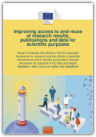
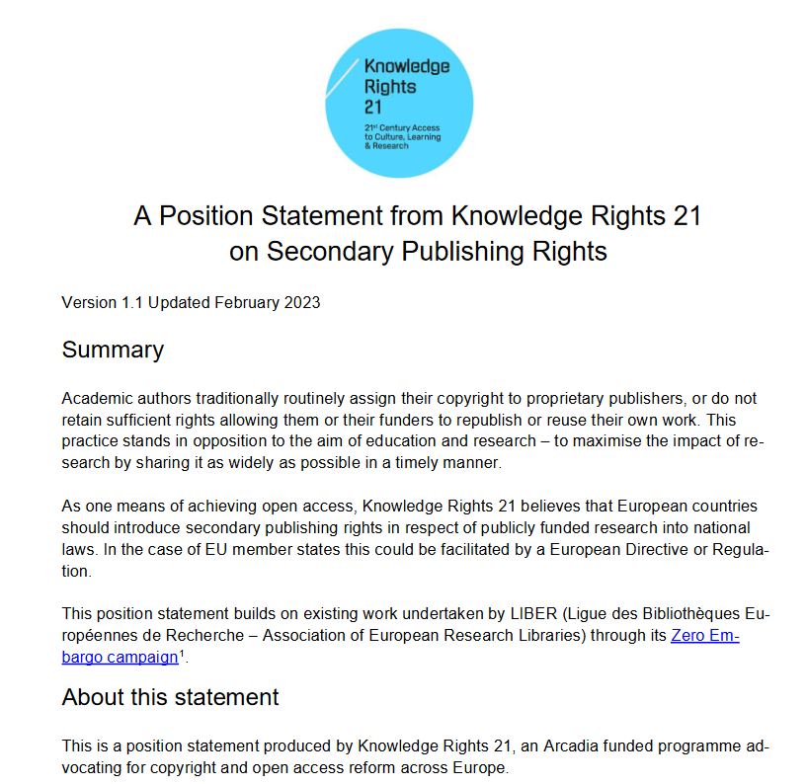
A hot topic at international and European level (2)
Council Conclusion on "A high-quality, transparent, open, reliable, and fair academic publication" (doc. 9616/23, May 23, 2023)
Political Agenda for the European Research Area - Overview of actions for the period 2022-2024 of the European Commission, one of the actions foreseen within the priority area "Deepening a fully functioning internal knowledge market" is the development of a legislative and regulatory framework suitable for research, which, among other things, allows: access to and reuse of publicly funded research results, including open access; access to and reuse of publications and data for research purposes; and the continuous flow of knowledge and research data across the EU, based on Article 179 TFEU and academic freedom.
European Commission, Improving access to and reuse of R&I results, publications, and data for scientific purposes - Study to assess the effects of the EU legislative framework on copyright and potential interventions
A Position Statement from Knowledge Rights 21 on Secondary Publishing Rights [2023] https://www.knowledgerights21.org/wp-content/uploads/2022/10/KR21-Secondary-Publishing-Rights-Position-paper-v1.1.pdf

Slide 8
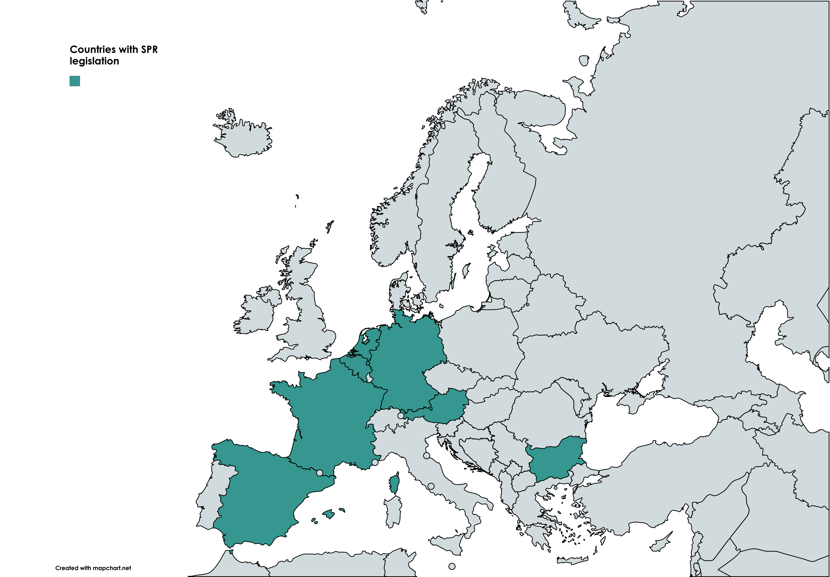
SPR across Europe

Slide 9
https://www.right2pub.eu/
Right2Pub – Balancing publication rights Project

Slide 10
Objectives
Support the right of republication in the scientific field at the national legislative level;
Promote awareness among researchers of the possibilities to retain the rights to their own works;
Focus attention on the limitations of the current legislation, which does not directly grant authors a right of republication
Promoted by the IGSG-CNR together with the 'Dario Nobili' Library of the CNR Research Area in Bologna, the Scientific Documentation Center and Library of the CNR Research Area in Pisa, and Creative Commons Italy Chapter.
Financed by Knowledge Rights 21

Slide 11
The context
Regulations differ significantly between member states.
Coalition S Organisation: Alliance of publicly funded research funders, promoting the extension of Open Access to all publicly financed research outcomes, has developed a Rights Retention Strategy to grant researchers supported by cOAlition S the freedom to submit manuscripts to their preferred journals, including subscription-based journals, while remaining fully compliant with Plan S

Slide 12
The 3 phases
Survey and data analysis
1 PHASE
Informative resources and training
2 PHASE
3 PHASE
Advocacy activity

Slide 13
Survey
Survey addressed to the entire CNR research community [open from November 10 to November 30, 2023]
6531 CNR researchers/technologists were invited to respond.
889 responded (13% of those invited)

Slide 14
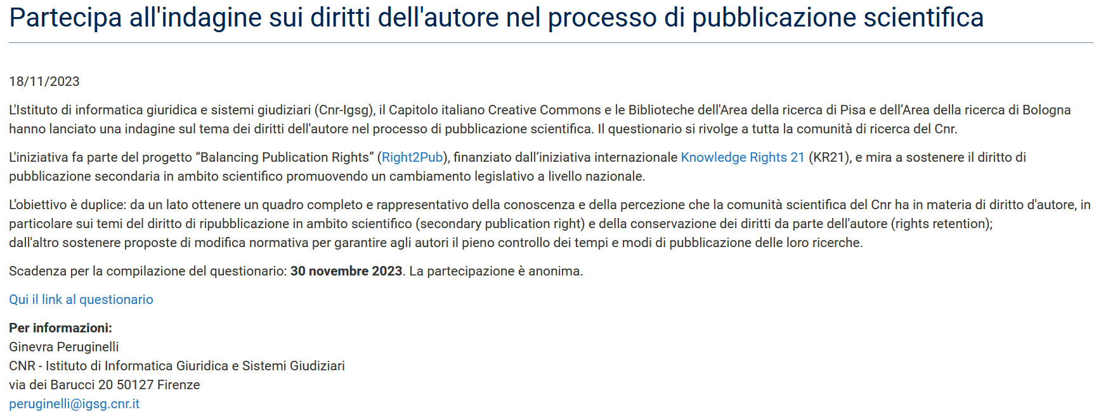
Survey 1. The questionnaire to researchers
Structure (26 questions)
Introductory Questions
Information on Scientific Production
Republishing of contributions
Awareness of Copyright Rights during Publication

Slide 15
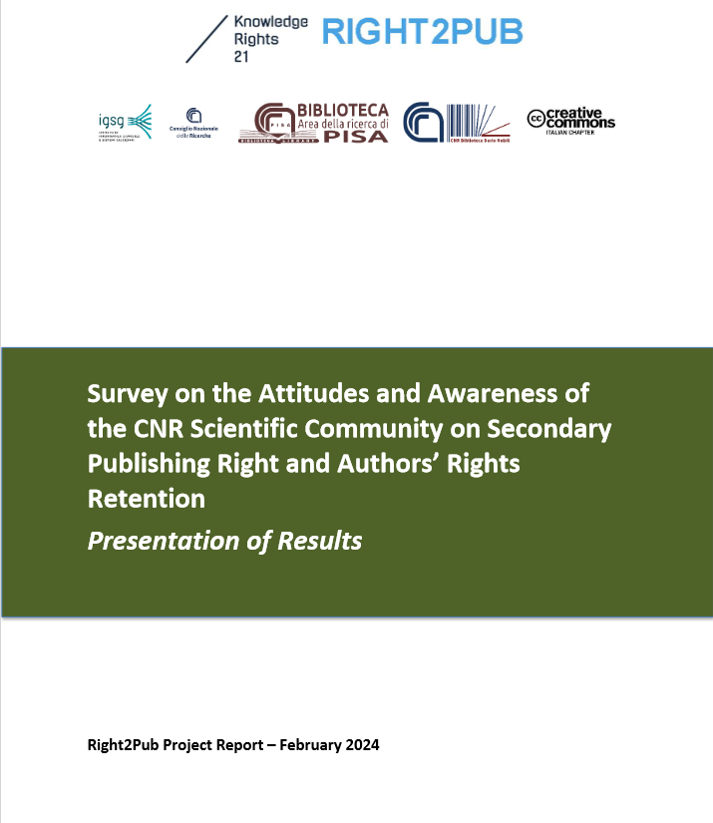
The report
DOI 10.5281/zenodo.10732324
DOI 10.5281/zenodo.10676034

Slide 16
The respondents profiles
Age Range: 69% of respondents fall within the 40-59 age range; only 2 respondents are under 30 years old, and 14% are between 30 and 39 years old.
Professional Level: 62% of respondents are at the basic level (researcher/technologist), and 12% of respondents are at the top level (research directors/technology directors). Research directors have shown the most interest in the survey (16% of those invited responded).
The most represented ERC sector is PE – Physical Sciences and Engineering, followed by LS – Life Sciences, and lastly by SSH – Social Sciences and Humanities.
73% of respondents declare that a significant part of their production has been entirely or partially funded by public financing.

Slide 17
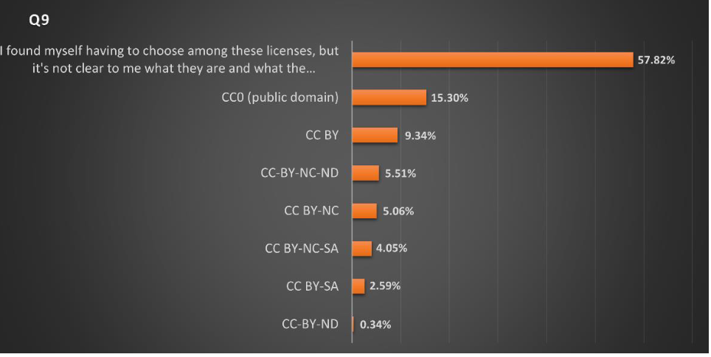
Q9. Given the choice, which type of public domain tool or Creative Commons copyright license do You prefer to be applied to Your outputs?

Slide 18
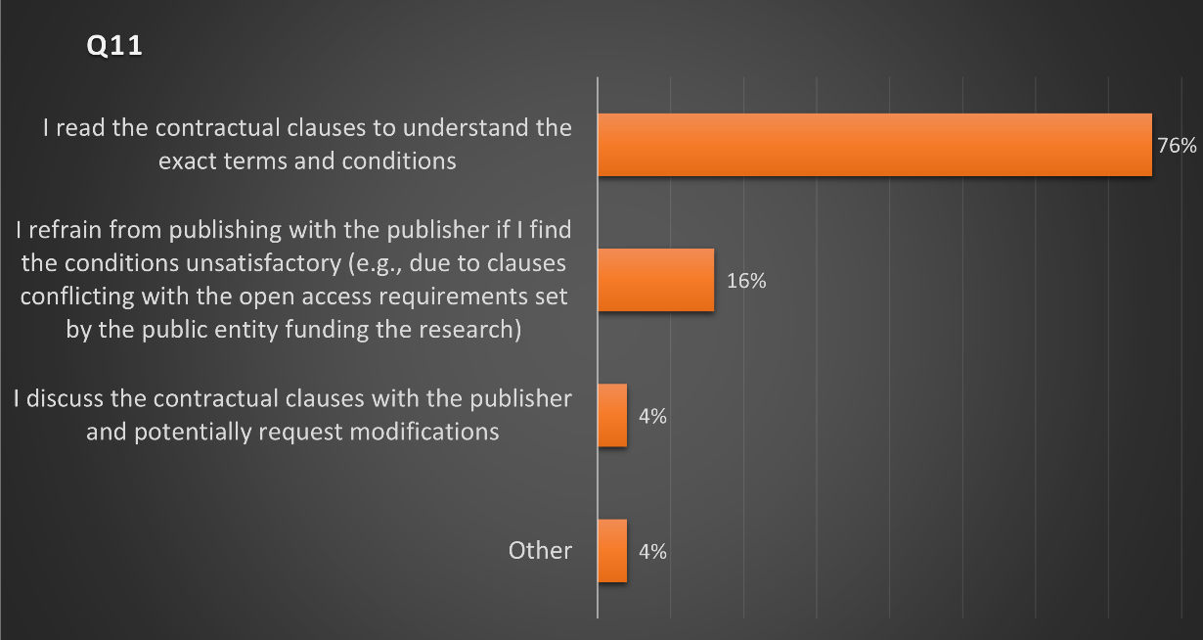
Q10. When You publish Your output, do You worry about verifying which rights you retain?
55% of respondents, by answering "no" to the question, declare that they do not worry about checking which rights they retain on their works when they publish.
Q11. If yes, how?

Slide 19
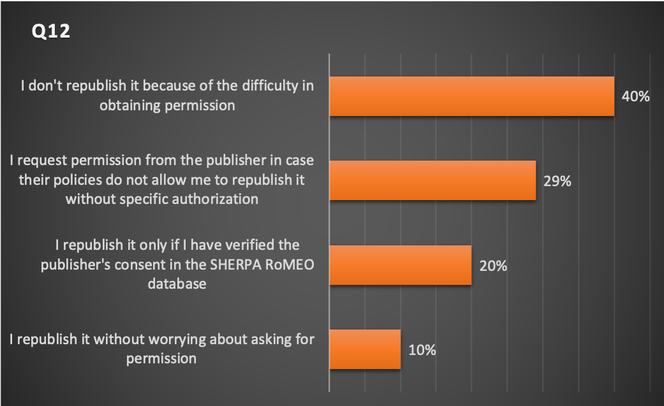
Q12. Once Your output is published in a commercial publishing venue, what do You do to republish it?

Slide 20
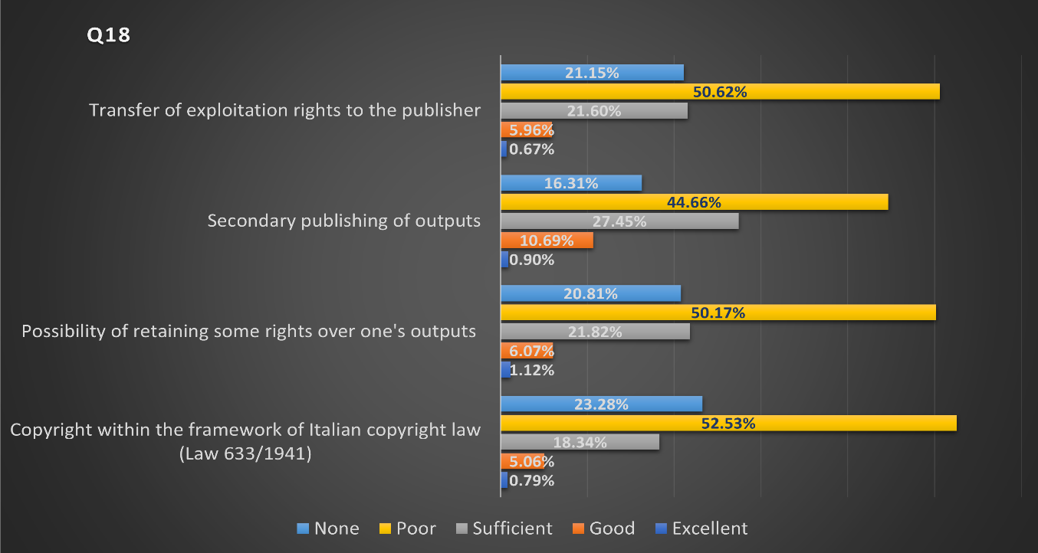
Q18. How would You rate your level of knowledge on these topics?
34% of respondents indicate they have no interest in copyright issues, while only 17% express a high level of interest.

Slide 21
Some final results
55% of respondents do not concern with verifying rights on their work when publishing.
75% lack awareness about the difference between "Version of Record" and "Author Accepted Manuscript."
Only 10% always deposit in preprint archives, while 27% always deposit in institutional or disciplinary archives.
Editorial policies regarding open licenses primarily influence publication venue choice.
81% would support legislation recognizing the right to immediately republish Open Access outputs funded with public funds.
71% are interested in participating in training events focused on publishing issues and copyright.

Slide 22
Survey 2. Focus group
December 13, 2023 , Pisa: 7 participants + 2 observers (2 hours)
December 14, 2023, Bologna: 8 participants (2 hours)
Some observations:
Authors generally adopt an individual approach to managing their publications without shared discussions on best practices.
Participants lack knowledge about OA rules, the nature of different existing repositories, and Italian copyright legislation.
Creative Commons licenses and Addenda are unfamiliar to most.
Some express doubts about researchers attending training events, as expertise in OA may not alter until the evaluation system changes; there's a perceived need to continue publishing using current methods.
More practical guidance is desired rather than theoretical information.

Slide 23
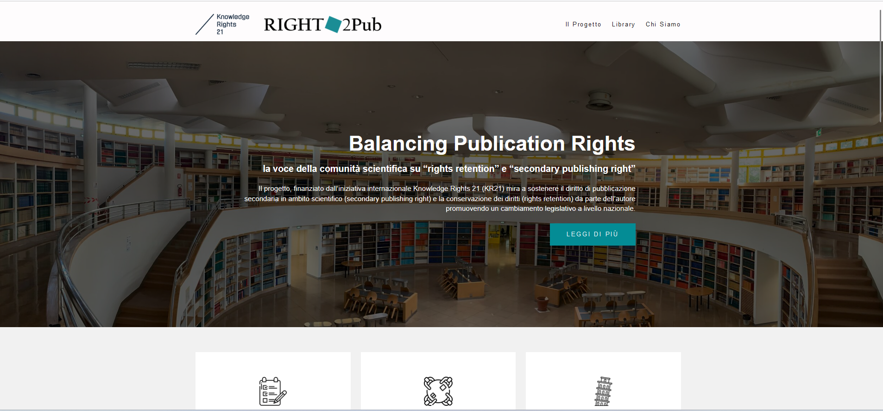
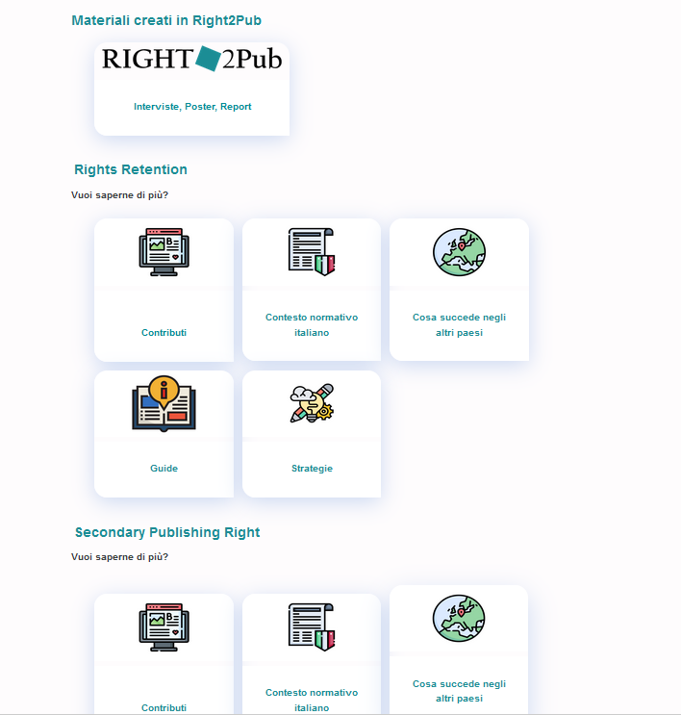
https://www.right2pub.eu/

Slide 24
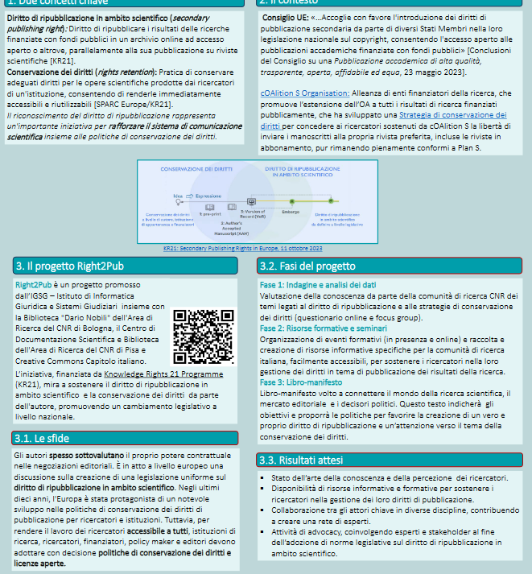
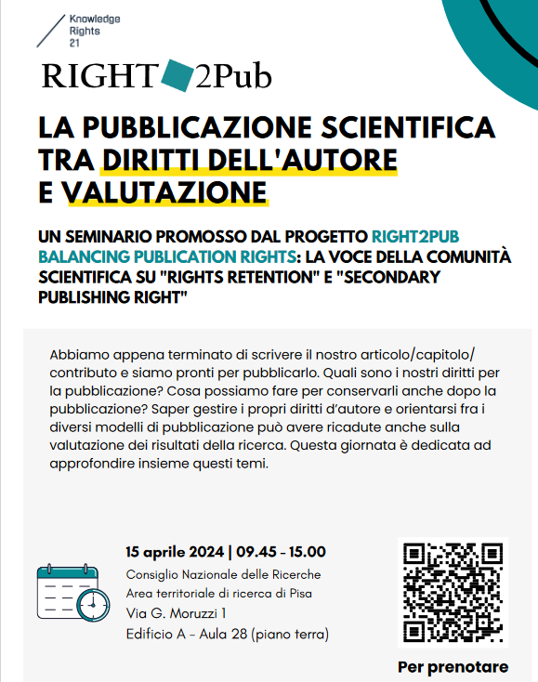
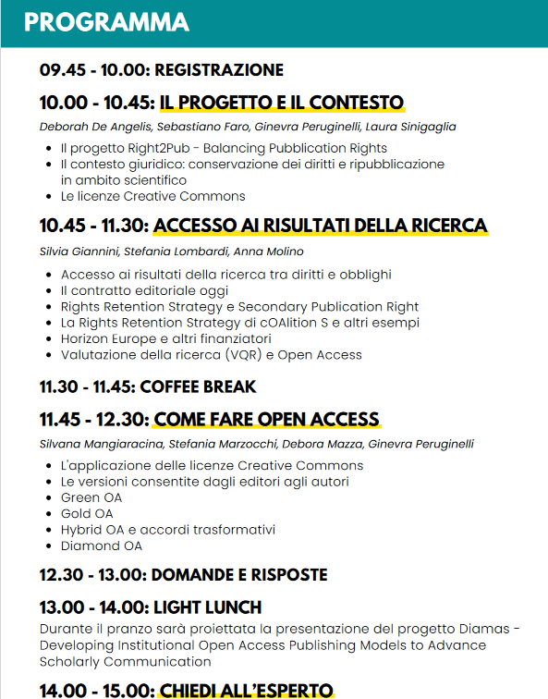
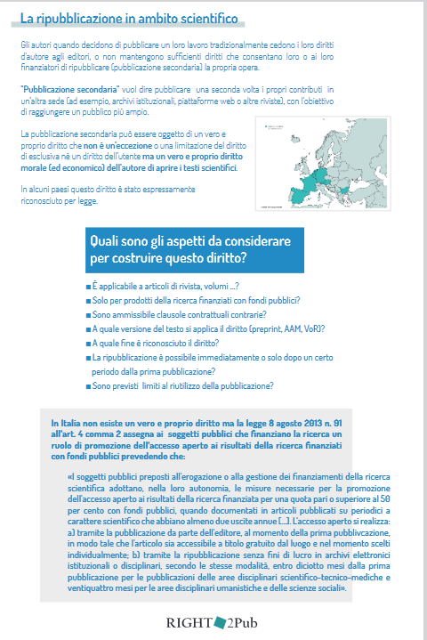
Informative resources + traning
15 aprile: Pisa
16 aprile: Bologna
Informative events to scientific community

Slide 25
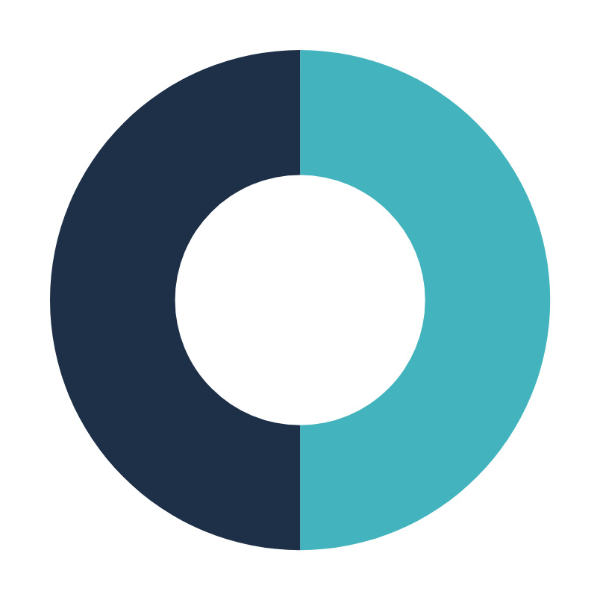
The third phase
Book
Network of experts
Guide for the scientific community

Slide 26
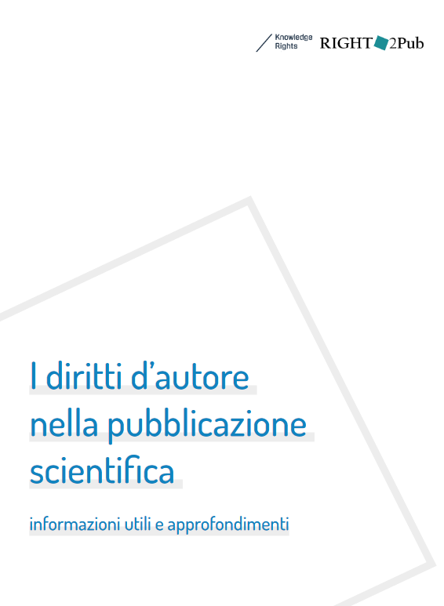
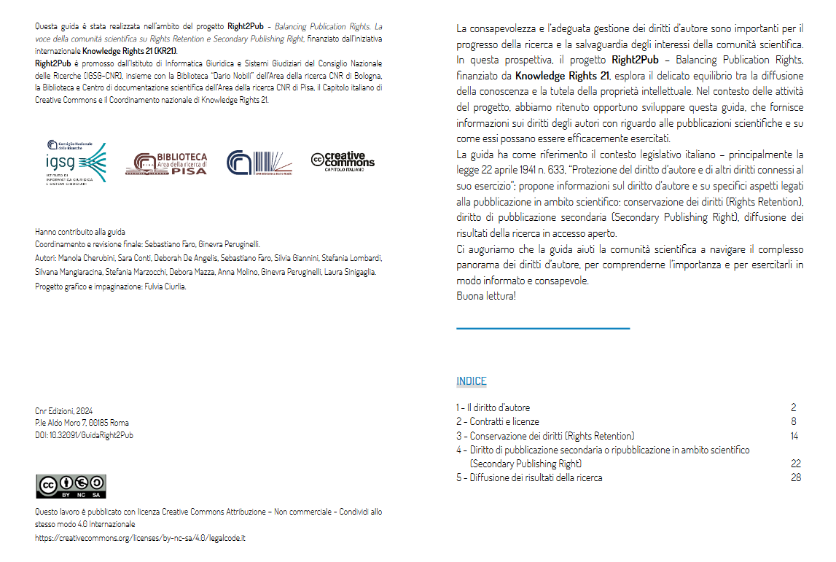
The Guide for reseachers

Slide 27
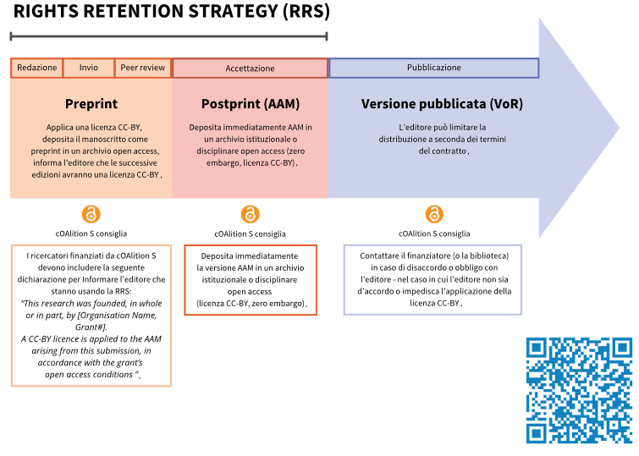
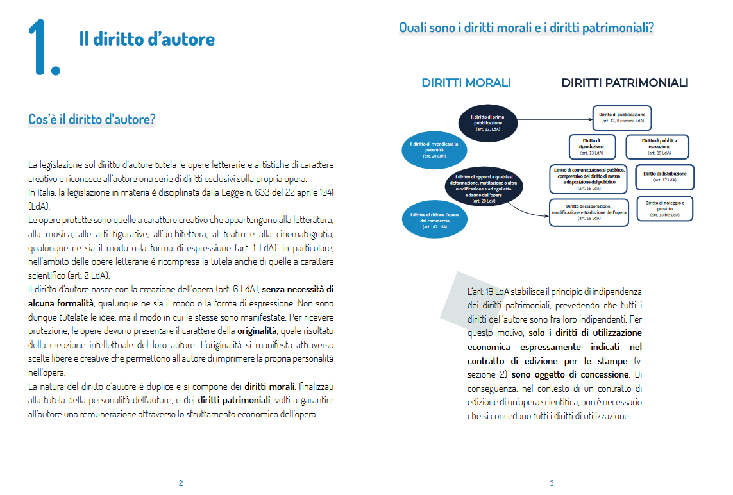
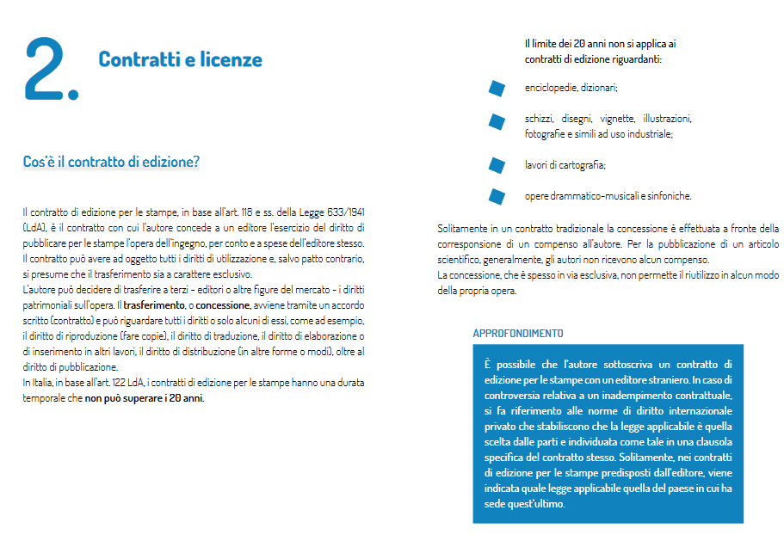
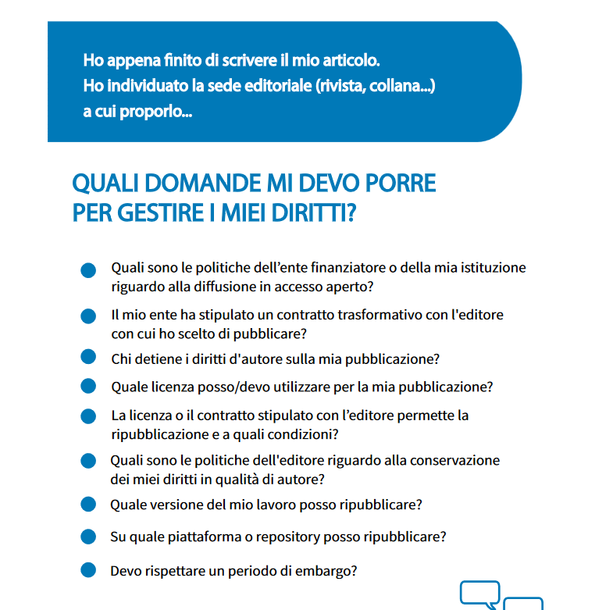
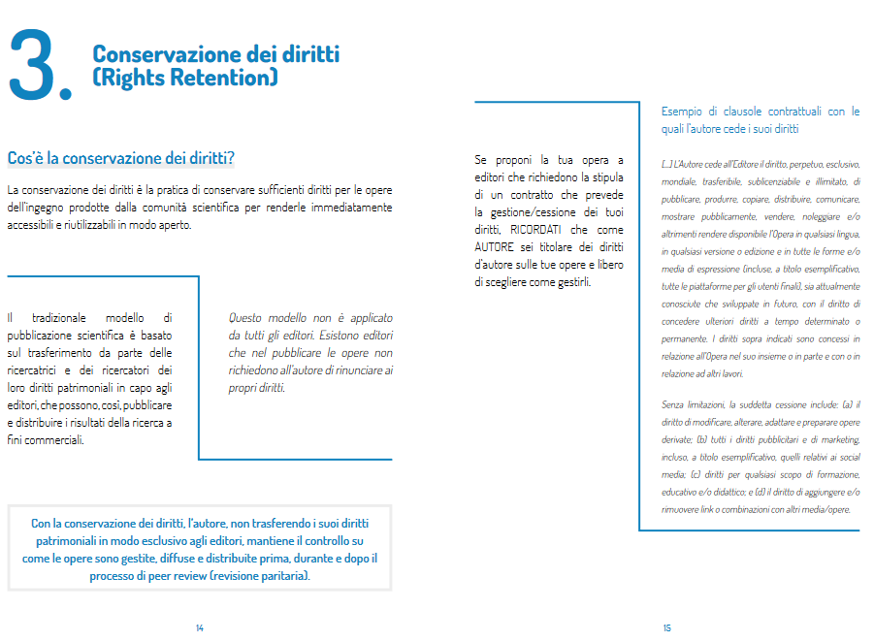
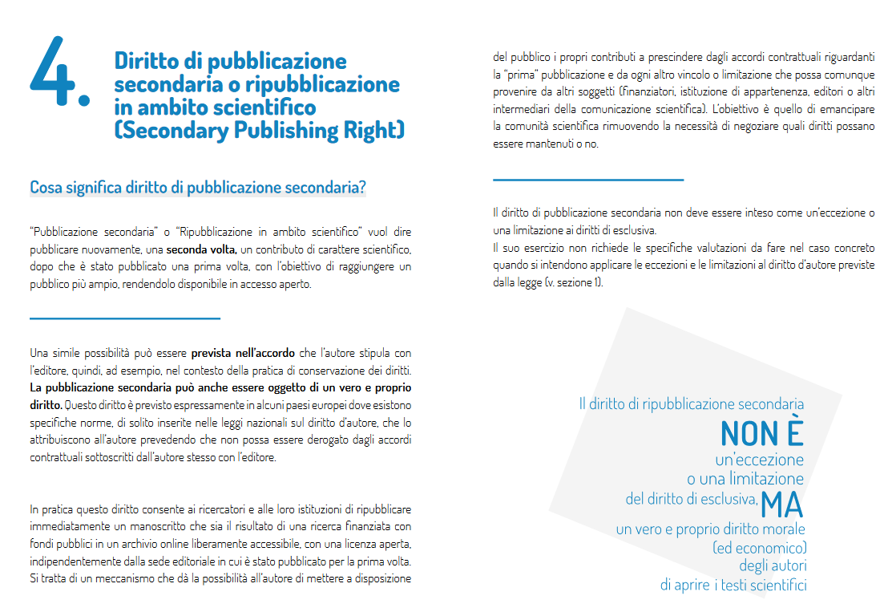
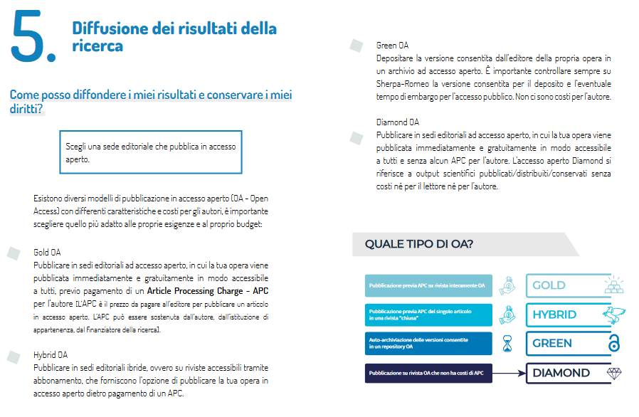
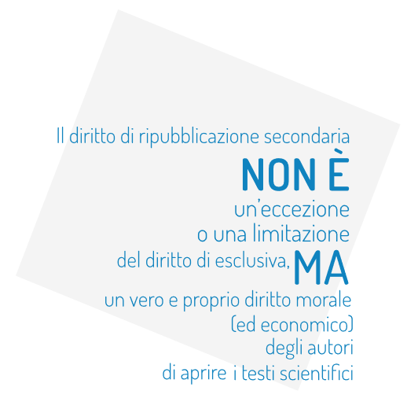

Slide 28
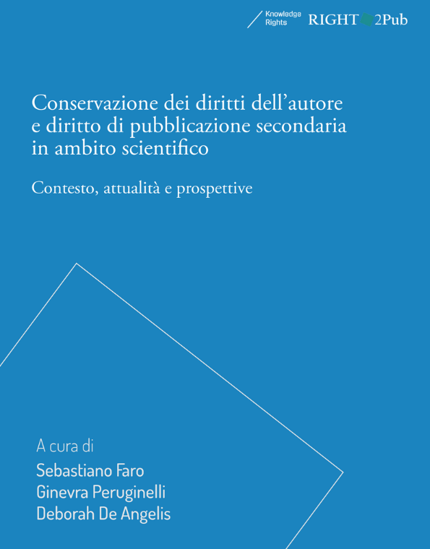
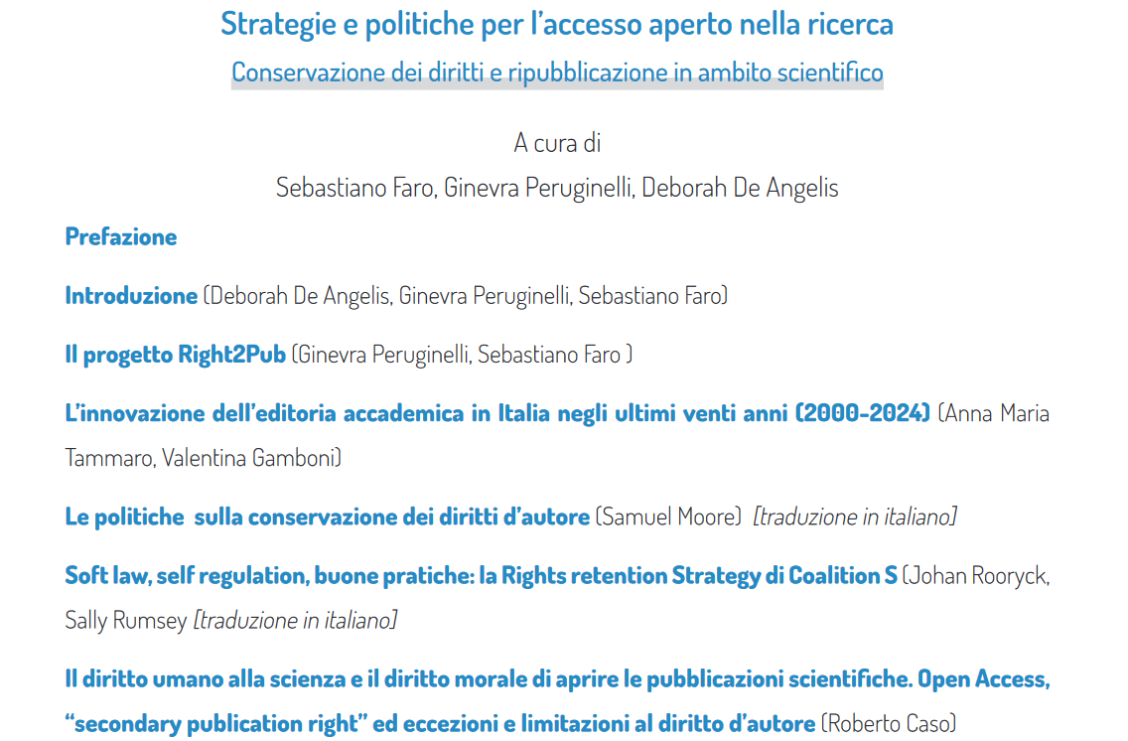
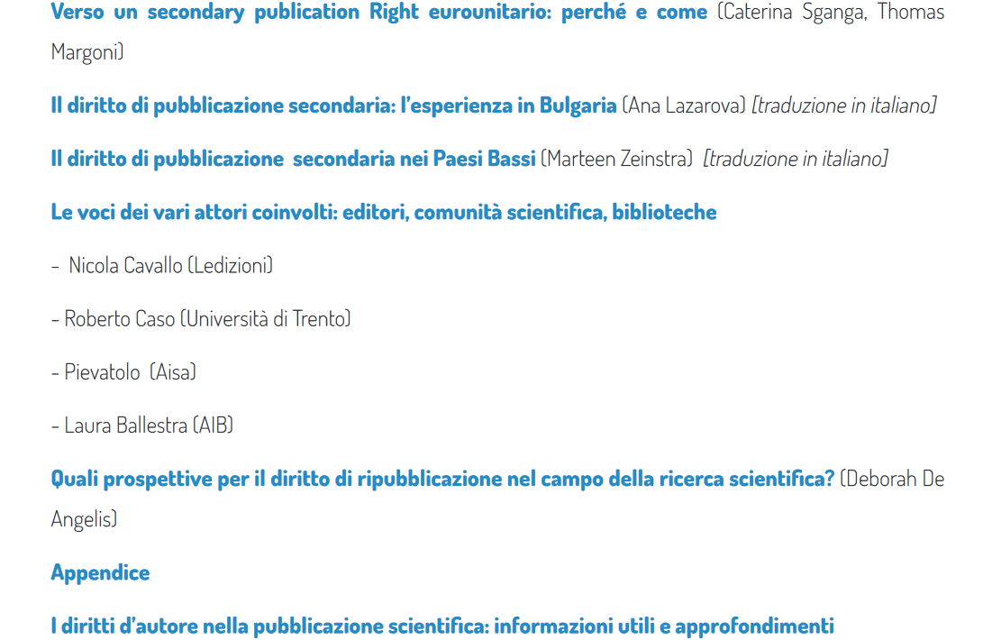
The Book
CNR Edizioni, Diamond OA book. DOI:
.

Slide 29
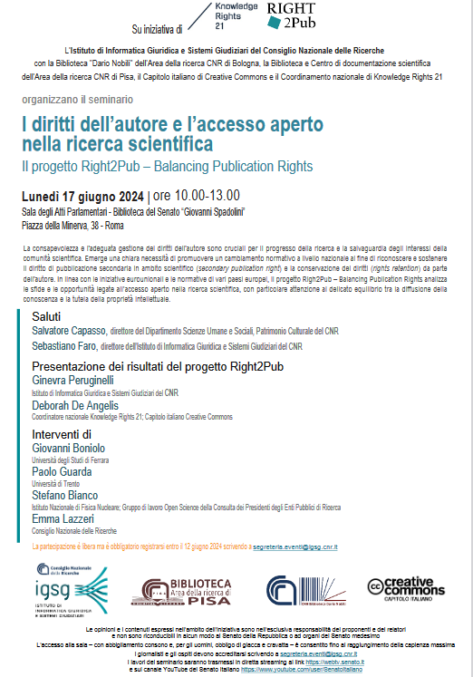
Presentation of the project results at the Senate House in the presence of parliamentarians and the Culture, Science, and Education Committees.

Slide 30
Institutional strategy
We need a comprehensive approach:
Regultations | Training | Support

Slide 31
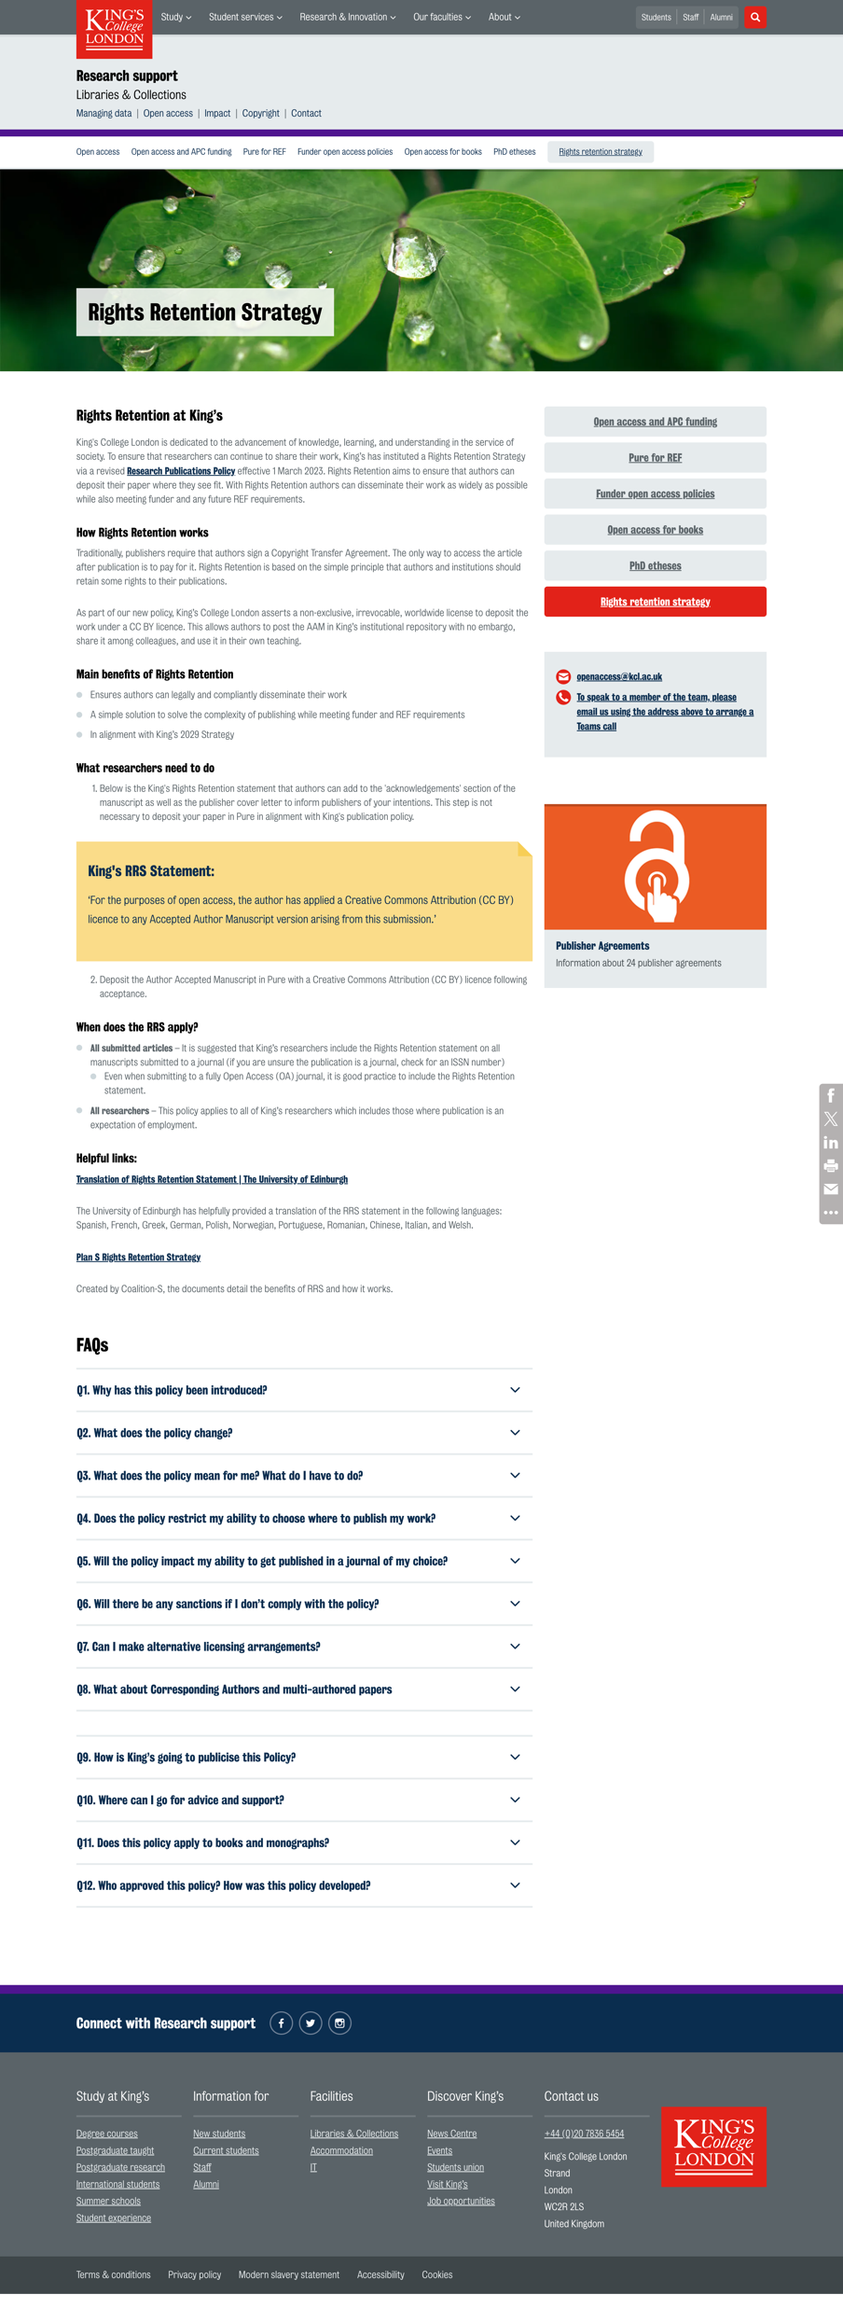
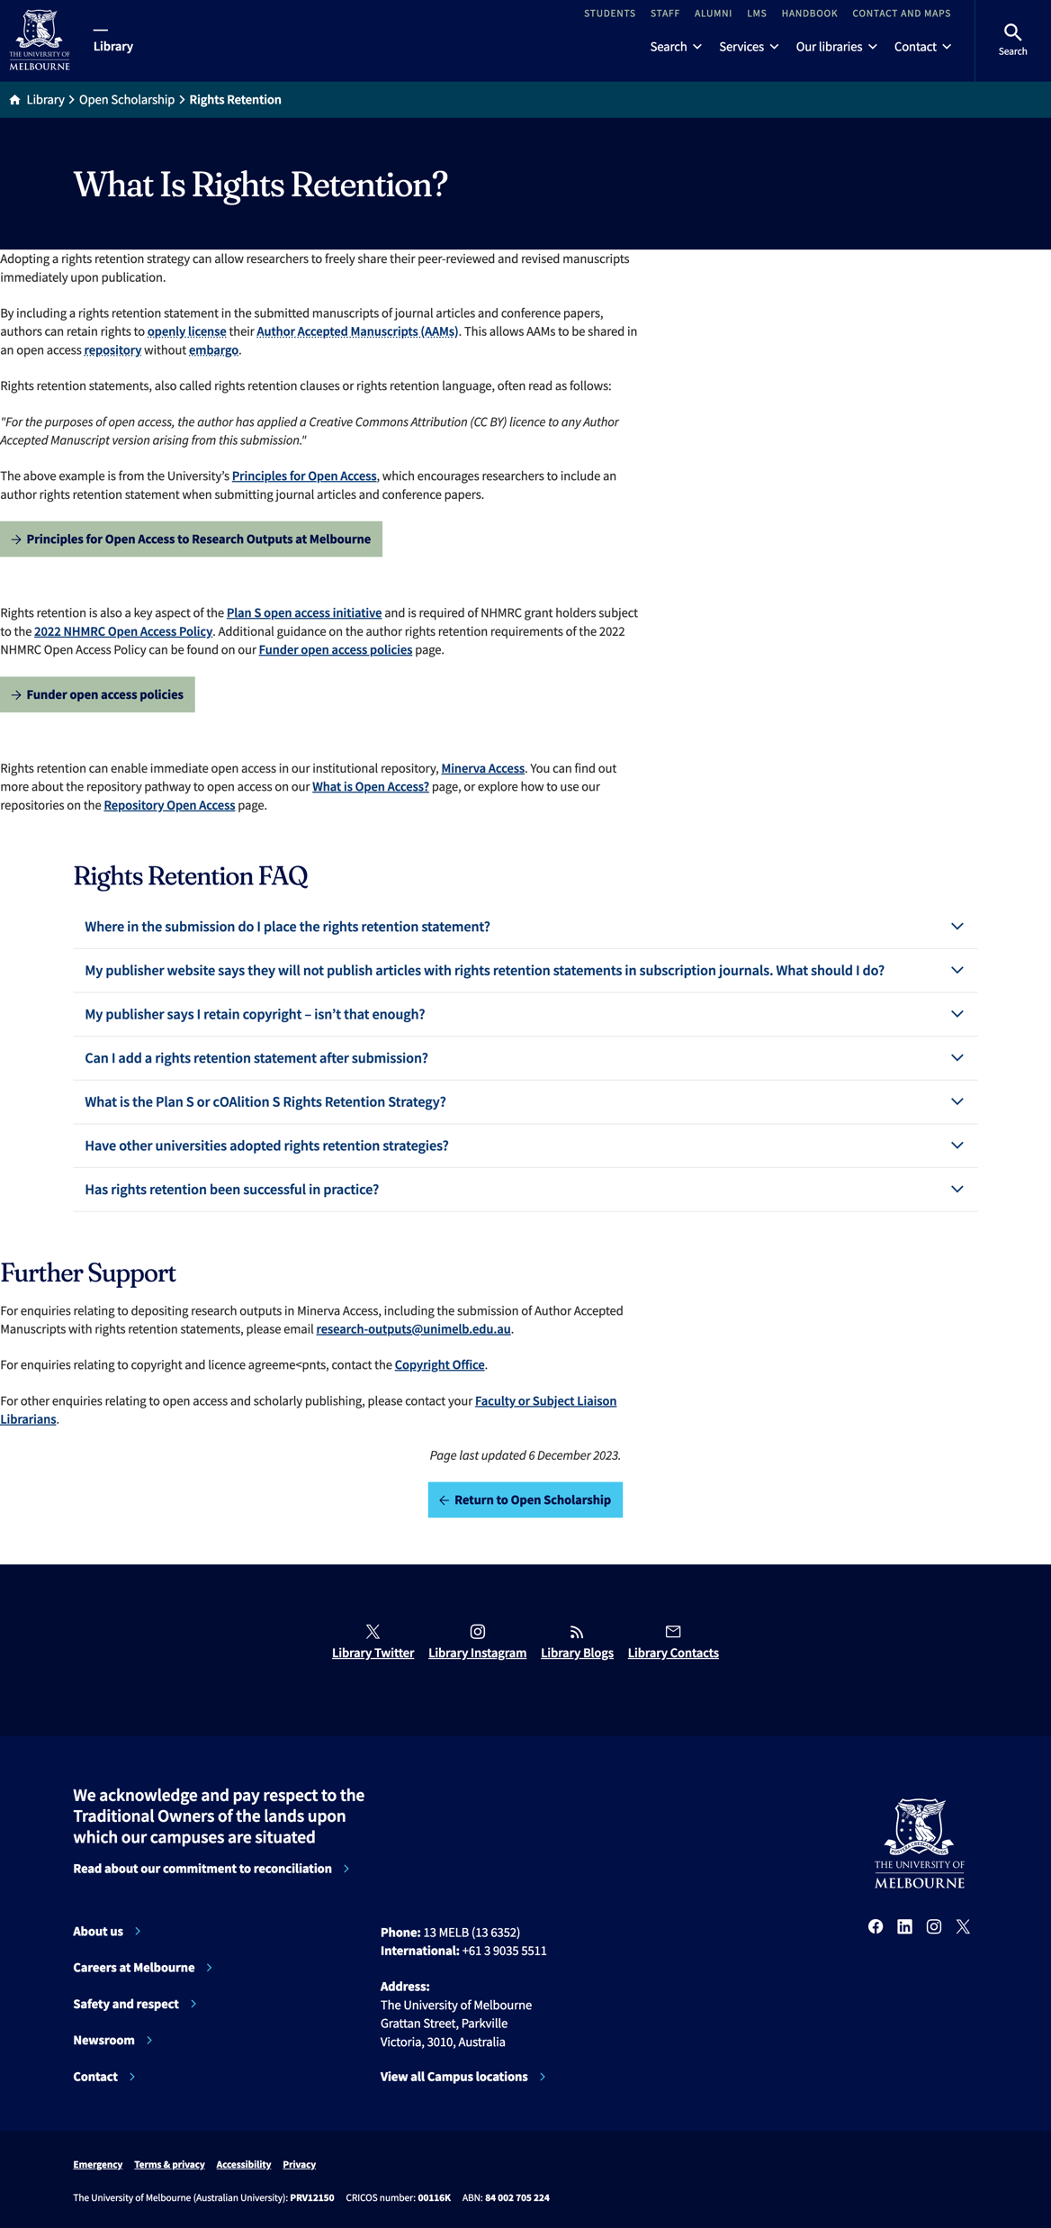
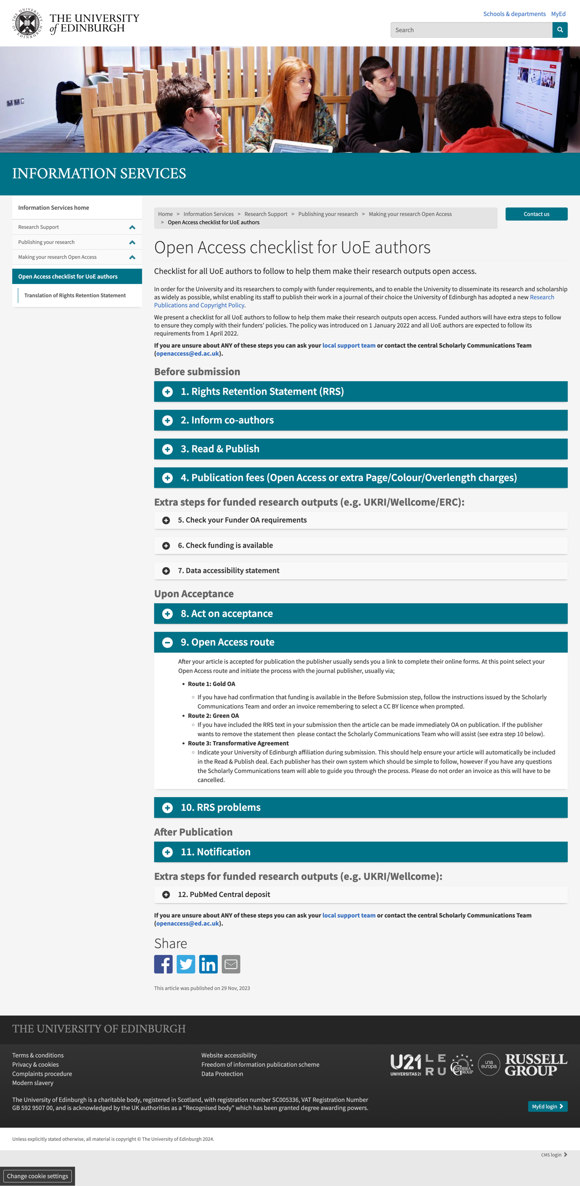
Examples of institutions adopting RRS
Harvard University (starting with the Faculty of Arts and Sciences in 2008)
Stanford University (starting with the School of Education in 2008)
Massachusetts Institute of Technology (MIT) (since 2009)
Auckland University of Technology (since 2020)
University of New South Wales (UNSW) (since 2021)
University of Cambridge (since 2022)
University of Oxford (since 2023)
And others…

Slide 32
Training
Training is critical at all levels:
Researchers need to be educated to raise awareness and encourage positive practices.
Legal and ethical experts require specific training on Open Access and Open Science to provide proper support.
Governance bodies must be adequately supported to develop and implement strategies that promote Open Access within their institutions.

Slide 33
Thank you!
Peruginelli@igsg.cnr.it

